Slide 1

Authentication

Slide 2
Authentication - Client
create the login form
Don’t forget the HTML <input type = “password”>
validate the fields on the client-side
JavaScript Validation API, Angular…
<input> required, lengths, type…
send the form data to the server by POST
HTTPS will send the form data encrypted *
e.g. <form method="post" action="/login">
Notes:
* Need to host with dedicated IP address, buy a SSL certificate from a CA, activate and install the certificate, then HTTPS should work. Update links to pages with sensitive info and protect it server-side.

Slide 3
Authentication - Server
validate again and sanitize the fields on the server
compute the hash of the sent password
compare the received details with the values stored in your database
if the values match, set the session variables
allow access to the resources/routes that require authentication
on log out, destroy the session variables

Slide 4
Authentication

Slide 5
JavaScript Validation API
<!DOCTYPE html>
<html>
<body>
<p>Enter a number and click OK:</p>
<input id="id1" type="number" min="100" max="300" required>
<button onclick="myFunction()">OK</button>
<p>If the number is less than 100 or greater than 300, an error message will be displayed.</p>
<p id="demo"></p>
<script>
function myFunction() {
inpObj = document.getElementById("id1");
if (!inpObj.checkValidity()) {
document.getElementById("demo").innerHTML = inpObj.validationMessage;
} else document.getElementById("demo").innerHTML = "Input OK";
}
</script>
</body>
</html>
Notes:
http://www.w3schools.com/js/js_validation_api.asp

Slide 6
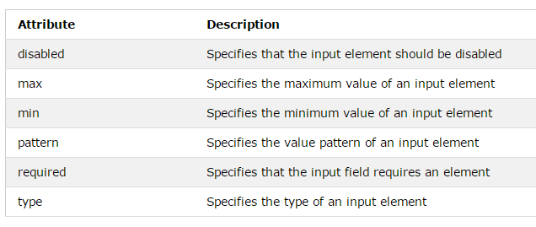
Validation HTML Input Attributes
A String pattern is like a regular expression, with "" instead of /^ $/
pattern="[A-Za-z]{3}" // 3 letters

Slide 7
Regular Expressions
Starts and ends with /
^ is the beginning
+ is one or more times the previous
* is zero or more times the previous
$ is the end
/^[0-9]+$/
at least one numeric char long
/^[a-zA-Z]+$/
both lowercase and uppercase letters
/^[0-9a-zA-Z]+$/
numbers and letters
Notes:
^ caret

Slide 8
Regular Expressions
Regular Expressions:
https://developer.mozilla.org/en/docs/Web/JavaScript/Guide/Regular_Expressions
Test Regular Expressions: https://regex101.com/
Your user’s passwords should have minimum lengths and format requirements, which you can check with regular expressions.

Slide 9
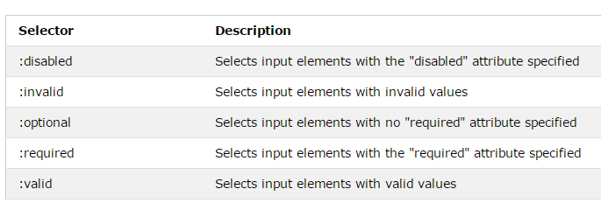
Validation CSS Pseudo Selectors
selector:pseudo-class {
property:value;
}
input:invalid | Selects all <input> elements with an invalid value

Slide 10
Input Validation
Client-side validation is performed to enhance the user experience and save bandwidth
Provide immediate feedback
Save trips to the server
However, you must always perform server-side validation as well, for security reasons
JavaScript can be bypassed
Input sanitization
Avoid code injection, cross-site scripting

Slide 11
Server-side Validation & Sanitization
https://express-validator.github.io/docs/
isLength
isEmail
trim
escape
custom
https://www.npmjs.com/package/validator
blacklist

Slide 12
Password Hashes on Node.js
In the DB, keep the passwords hashed
bcrypt is the de facto way to hash passwords
store the result in a field with ~255 characters
https://www.npmjs.com/package/bcrypt
const bcrypt = require('bcrypt');
const saltRounds = 10;
bcrypt.hash(myPlaintextPassword, saltRounds, function(err, hash) {
// Store hash in your password DB.
});
// hash is loaded from your DB.
bcrypt.compare(myPlaintextPassword, hash, function(err, result) {
if(result) {
// Passwords match
} else {
// Passwords don't match
}
});

Slide 13
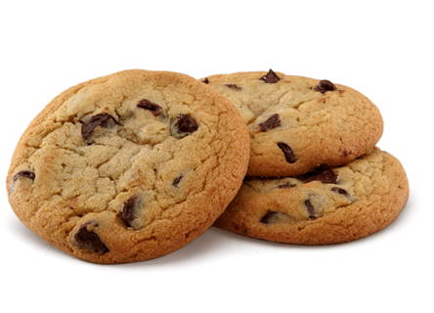
Sessions

Slide 14
Sessions
Sessions set a user-key/ID on the user's computer
Web storage: client-side sessions, to allow separate instances of the same web app to run in different windows without interfering with each other
Traditional cookies: communication with server
When you open a page, it scans the computer for a user-key
If there is a match, it accesses that session
If not, it starts a new session
Session data is not saved in the cookie, just the session ID
Session data is stored server-side
You might recall $_SESSION from PHP:
$_SESSION["favanimal"] = "cat";
In Node/Express, you need to add an appropriate store to manage this data
The most popular is Redis
Officially, Redis is not supported on Windows, but you can still install it:
https://redislabs.com/blog/redis-on-windows-8-1-and-previous-versions/
https://www.redislabs.com/blog/redis-on-windows-10/
Notes:
PHP sessions: on the client, the session ID is stored as a cookie with the name PHPSESSID

Slide 15
HTTP Cookies
The HTTP protocol is stateless
originally only static pages were served upon request
With the development of personalization, in order to maintain information on the server about state (authentication, number of visits, preferences…), cookies were created
They are a mechanism for servers to both store and retrieve information on the client-side, until they expire
A server can send cookies to the client
If the browser accepts it, it is stored as plain text
Then, in subsequent visits, the browser sends the same cookie to the server.
A cookie can also be created by client-side JavaScript; if so, it can be read/written to by the client, as well as by the server
document.cookie = "key1=value1;key2=value2;expires=date";
when you read the cookie , you can only see the key=value bits
it works as a String that you can append more key=value(s) to

Slide 16
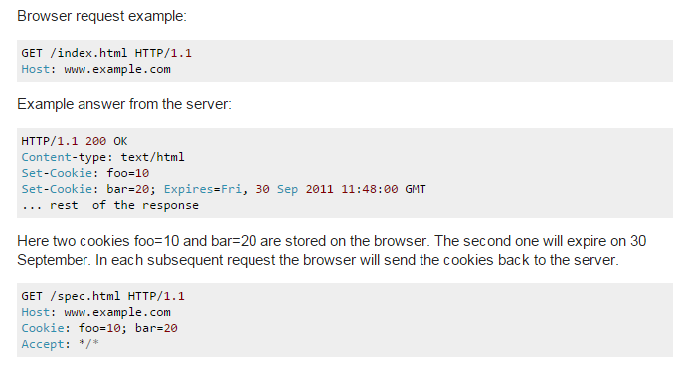
How Cookies Work

Slide 17
Cookies
Cookie parameters (all optional except the last):
Expires: The date the cookie will expire. If this is blank, the cookie will expire and be deleted when the visitor closes the browser: a session cookie
when Chrome or Firefox are configured to reopen tabs from last time upon start, they will keep session cookies when closing the browser, making them act as persistent cookies
Domain: The domain name of the website.
Path: The path to the directory or web page that set the cookie. By default it is '/' , so you can retrieve the cookie from any directory or page.
Secure: If the cookie contains the word "Secure", the cookie may only be retrieved with a secure server (HTTPS).

Slide 18
Cookies
HttpOnly: directs browsers not to expose cookies through channels other than HTTP (and HTTPS) requests, and thus not accessible via client-side JavaScript (using document.cookie)
Name=Value: cookies have the form of key and value pairs. Values may not include semicolons, commas, or whitespace.
Browsers do not send the cookie attributes back to the server, just name and value.
The attributes are used by the browser to determine when to delete a cookie, accept or block a cookie, etc.
Beware of the EU Cookie Laws and GDPR!
Requires asking permission from users before planting cookies, and including details on their purpose.

Slide 19

Express Sessions
https://www.npmjs.com/package/express-session
The default cookie settings are { path: '/', httpOnly: true, secure: false, maxAge: null }.
maxAge is the number of milliseconds to add to the current date to calculate the Expires parameter
The default name of the cookie is 'connect.sid'.
npm install express-session
var session = require('express-session');
var app = express();
app.use(session({
secret: 'keyboard cat', // used to sign the session ID cookie
resave: false, // session NOT saved back to the store if not modified
saveUninitialized: true, // choosing false is useful for login sessions
cookie: { maxAge: 60000 }
}));

Slide 20

Redis Data Store
https://www.npmjs.com/package/connect-redis
npm install redis connect-redis
C:\Program Files\Redis>redis-server
To store or access session data, use req.session (in JSON)
const redis = require('redis');
const session = require('express-session');
let RedisStore = require('connect-redis')(session);
let redisClient = redis.createClient();
app.use(
session({
store: new RedisStore({ client: redisClient }), // default host: 'localhost', port: 6379
secret: 'keyboard cat',
resave: false,
saveUninitialized: true
});
);

Slide 21
Example: visit counter per route
let RedisStore = require('connect-redis')(session);
let redisClient = redis.createClient();
app.use(
session({
store: new RedisStore({ client: redisClient }),
secret: 'keyboard cat',
resave: false,
saveUninitialized: true
})
);
app.use(function (req, res, next) {
if (!req.session.views)
req.session.views = {};
var pathname = parseurl(req).pathname;
req.session.views[pathname] = (req.session.views[pathname] || 0) + 1;
next();
});
app.get('/foo', function (req, res, next) {
res.send('you viewed this page ' + req.session.views['/foo'] + ' times');
});
app.get('/bar', function (req, res, next) {
res.send('you viewed this page ' + req.session.views['/bar'] + ' times');
});

Slide 22
Destroy Session
Session.destroy(callback);
Destroys the session and will unset the req.session property.
Once complete, the callback will be invoked.
Example:
app.post("/logout", function (req, res){
req.session.destroy( function (err) {
if(err) return console.log(err);
res.send("You have been logged out.");
});
});

Slide 23
Questions?

